Slide 1
Skills Bootcamp Classroom Rules
Be on time: Just like in a physical classroom, it's important to be punctual for your online class. Log in to the virtual classroom a few minutes before the class starts.
Turn Cameras on: In order to maximise your learning studies show that being able to see your peers and your tutor being able to see you can increase motivations and retention, therefore we ask to keep your cameras on.
Attend all classes: In order to be successful in your bootcamp studies you need to attend all live sessions, therefore you should prioritise and make time for these sessions.
Avoid distractions: Turn off your phone notifications, close any other unnecessary tabs, and focus solely on the class.
Participate actively: It's important to be an active participant in the class. Ask questions, answer questions, and participate in discussions.
Use proper language and tone: Use respectful language and tone when communicating with your classmates and instructor. Avoid using slang or inappropriate language.
Respect others' opinions: Be respectful of others' opinions, even if they differ from your own. Avoid making negative comments or attacking others.
Follow the instructor's guidelines: Follow the instructor's guidelines, such as submitting assignments on time.
Be polite: Be polite and respectful to everyone in the class, including the instructor, classmates, and guest speakers.
Dress appropriately: Even though you are not in a physical classroom, it's important to dress appropriately. Dress as if you were going to a face-to-face class.
Use appropriate technology: Ensure that you have the necessary equipment, such as a reliable internet connection, a microphone, and a webcam, and that they are in good working condition.

Slide 2
Software Developer Bootcamp
Unit 1 – Introduction to Software Development
Week 2C

Slide 3
Learning Outcomes
Following this session, you should be able to:
Concept of software platforms and the importance of platform-specific design and development.
Cross-platform development and its challenges.
Platform-specific performance optimisation techniques.
Considerations for cloud vs. on-premises software deployments.
Platform security considerations.
Understand flowchart symbols.
Notes:
Today, we'll explore the multifaceted world of software platforms, a topic that's crucial for anyone in the software industry. Our journey today will cover five key areas, each designed to meet specific SMART learning objectives. We'll also delve into real-world case studies to tie these concepts together.

Slide 4
Concept of Software Platforms

Slide 5

What is a Software Platform?
A software platform is a set of tools, libraries, and other components that provide a foundation for software development.
It is a collection of software components that can be used to create applications and services.
It provides a common set of APIs, libraries, and other components that can be used to develop applications.
Notes:
A software platform is more than just an operating system or a runtime environment. The foundational layer supports the application, providing essential services and libraries that the software relies upon.

Slide 6

Types of Software Platforms
There are several types of software platforms, including web platforms, mobile platforms, and desktop platforms.
Web platforms are used to create web applications and services, while mobile platforms are used to create mobile applications.
Desktop platforms are used to create desktop applications, and there are also game platforms for creating games.
Notes:
From operating systems like Windows and Linux to web browsers like Chrome and Firefox and even cloud environments like AWS and Azure, each has its own set of rules, capabilities, and limitations.

Slide 7

Benefits of Software Platforms
Software platforms provide a number of benefits to developers, including faster development times, easier maintenance, and better scalability.
They also provide a common set of APIs and libraries that can be used to create applications quickly and easily.
In addition, software platforms can help reduce the cost of development by providing a common set of tools and components that can be used across multiple projects.
Notes:
Designing with the platform in mind is not just a luxury; it's a necessity. It ensures that your software leverages the platform's strengths while avoiding its weaknesses.

Slide 8

Examples of Software Platforms
Some of the most popular software platforms include Windows, Linux, Mac OS X, iOS, Android, and the .NET Framework.
Each of these platforms has its own set of APIs, libraries, and other components that can be used to create applications.
In addition, there are a number of other software platforms that are used for specific purposes, such as game development, web development, and mobile development.

Slide 9

Advantages of Software Platforms
Software platforms provide a number of advantages to developers, including faster development times, easier maintenance, and better scalability.
They also provide a common set of APIs and libraries that can be used to create applications quickly and easily.
In addition, software platforms can help reduce the cost of development by providing a common set of tools and components that can be used across multiple projects.
Notes:
Software platforms provide a number of benefits to developers, including faster development times, easier maintenance, and better scalability.
They also provide a common set of APIs and libraries that can be used to create applications quickly and easily.
In addition, software platforms can help reduce the cost of development by providing a common set of tools and components that can be used across multiple projects.

Slide 10
Importance of Platform-Specific Design and Development

Slide 11

What is Platform-Specific Design and Development?
Platform-specific design and development is the process of creating a unique user experience for each platform or device.
This includes taking into account the different features, capabilities, and limitations of each platform.
It also involves creating a design that is tailored to the user’s needs and expectations on that platform.
Notes:
Designing with the platform in mind is not just a luxury; it's a necessity. It ensures that your software leverages the platform's strengths while avoiding its weaknesses. Performance, native features, and user experience are the trifecta of platform-specific design. Ignoring any of these can result in software that's sluggish, feature-poor, or frustrating to use.

Slide 12

Why is Platform-Specific Design and Development Important?
Platform-specific design and development is important because it allows you to create a unique experience for each platform or device.
This ensures that users have the best possible experience when using your product or service.
It also allows you to take advantage of the features and capabilities of each platform, which can help you create a more engaging and effective user experience.

Slide 13

How to Implement Platform-Specific Design and Development
When implementing platform-specific design and development, it is important to consider the different features, capabilities, and limitations of each platform.
You should also consider the user’s needs and expectations on that platform.
It is also important to create a design that is tailored to the user’s needs and expectations on that platform.

Slide 14

Benefits of Platform-Specific Design and Development
Platform-specific design and development can help you create a more engaging and effective user experience.
It can also help you take advantage of the features and capabilities of each platform.
Finally, it can help you create a unique experience for each platform or device, which can help you stand out from the competition.
Notes:
Platform-specific design and development is important in creating a successful product or service.
It is important to consider each platform's different features, capabilities, and limitations when implementing platform-specific design and development.
It is also important to create a design tailored to the user’s needs and expectations on that platform to create a more engaging and effective user experience.

Slide 15
Cross-Platform Development and Its Challenges

Slide 16

What is Cross-Platform Development?
Cross-platform development is the process of creating software applications that can be used on multiple platforms, such as Windows, Mac, iOS, and Android.
It is a cost-effective way to develop applications that can be used on multiple platforms without having to create separate versions for each platform.
Notes:
Cross-platform development is the Swiss Army knife of software engineering. It promises code reusability across platforms but is not a one-size-fits-all solution.

Slide 17

Challenges of Cross-Platform Development
Cross-platform development can be challenging, as it requires developers to be familiar with multiple platforms and their respective development tools.
It can also be difficult to ensure that the application works properly on all platforms, as each platform has its own set of rules and guidelines.
Cross-platform development can also be time-consuming, as it requires developers to test the application on multiple platforms to ensure that it works properly.
Notes:
While it sounds ideal, cross-platform development can lead to performance bottlenecks, inconsistent behaviours, and a maintenance nightmare if not managed carefully.

Slide 18

Tools for Cross-Platform Development
There are a variety of tools available for cross-platform development, such as Xamarin, React Native, and Flutter.
These tools allow developers to create applications that can be used on multiple platforms without having to create separate versions for each platform.
These tools also provide developers with a variety of features, such as debugging tools, UI components, and more.

Slide 19

Best Practices for Cross-Platform Development
When developing a cross-platform application, it is important to keep the following best practices in mind:
- Test the application on multiple platforms to ensure that it works properly.
- Use the same codebase for all platforms to reduce development time and effort.
- Use debugging tools to identify and fix any issues with the application.
- Follow the guidelines of each platform to ensure that the application meets the requirements of each platform.

Slide 20

Benefits of Cross-Platform Development
Cross-platform development is cost-effective, as it eliminates the need to create separate versions of the same application for different platforms.
It also allows developers to use the same codebase for multiple platforms, which reduces development time and effort.
Cross-platform development also allows developers to reach a wider audience, as the application can be used on multiple platforms.
Notes:
Cross-platform development is a cost-effective way to develop applications that can be used on multiple platforms.
However, it can be challenging and time-consuming, as it requires developers to be familiar with multiple platforms and their respective development tools.
By following the best practices for cross-platform development, developers can ensure that their applications are successful on all platforms.

Slide 21
Platform-specific Performance Optimisation Techniques

Slide 22

Platform-specific Optimisation
What is platform-specific optimisation?
Why is it important?
How can it be achieved?
Notes:
Performance optimisation is an art. It's about squeezing every last drop of efficiency from your code, but the techniques vary widely depending on the platform.

Slide 23

Platform-specific Optimisation Strategies
Platform-specific code optimisation
Platform-specific memory optimisation
Platform-specific data optimisation
Notes:
Whether it's caching in a web browser, load balancing in a cloud environment, or asynchronous operations in a mobile app, each platform has its best optimisation practices.

Slide 24

Platform-specific Code Optimisation
Using platform-specific instructions
Using platform-specific libraries
Using platform-specific compilers

Slide 25
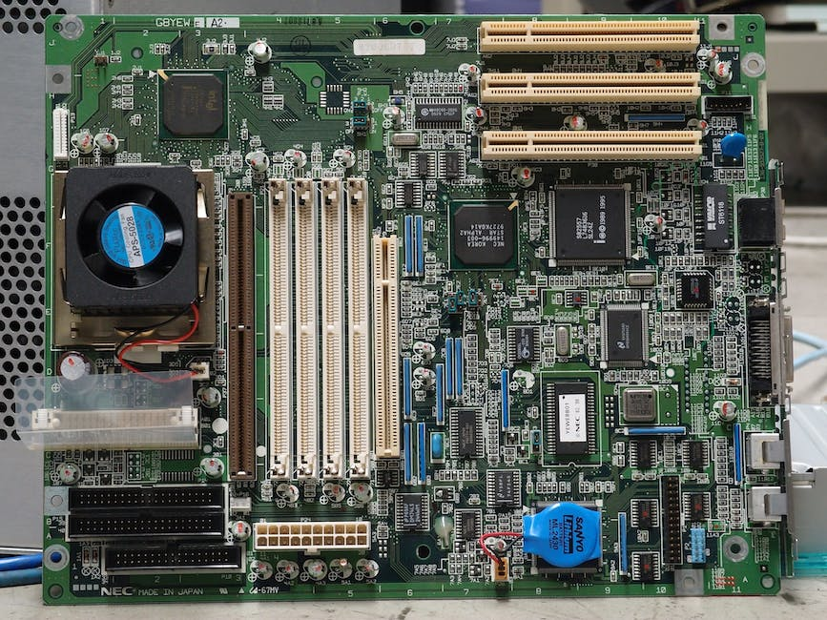
Platform-specific Memory Optimisation
Using platform-specific memory management techniques
Using platform-specific caching techniques
Using platform-specific memory allocation techniques

Slide 26

Platform-specific Data Optimisation
Using platform-specific data structures
Using platform-specific data compression techniques
Using platform-specific data storage techniques
Notes:
Platform-specific optimisation is essential for maximising performance across platforms
Platform-specific code, memory and data optimisation strategies can be used to tailor performance to platforms
Platform-specific optimisation can help to ensure that applications are running at their best on any platform

Slide 27
Considerations for Cloud vs. On-Premises Software Deployments

Slide 28

Cost
Cost of hardware and software
Cost of maintenance and upgrades
Cost of data storage and bandwidth
Notes:
The decision between cloud and on-premises deployments affects not just cost but also how your application scales and how much control you have over your data. Cost, scalability, and control are the pillars of deployment considerations. Each has its pros and cons, and the best choice depends on your specific needs.

Slide 29

Security
Data security and privacy
Access control and authentication
Data backup and disaster recovery
Notes:
Security is not an afterthought; it's a foundational aspect of software development. Each platform comes with its own set of security features and potential vulnerabilities. Implementing security measures like encryption, authentication, and regular updates is crucial, but how you implement them can vary significantly from one platform to another.

Slide 30

Scalability
Ability to scale up or down quickly
Flexibility to add or remove resources
Ease of adding new users
Notes:
1. Ability to Scale Up or Down Quickly: Scalability is key. Whether user numbers spike or dip, your platform must adapt quickly to maintain performance and control costs.
2. Flexibility to Add or Remove Resources: Your platform should be modular, allowing for easy addition or removal of features to meet evolving needs.
3. Ease of Adding New Users: Adding new users should be straightforward in terms of interface and permissions to encourage platform adoption.

Slide 31

Performance
Network latency and bandwidth
Data processing speed
Reliability and availability
Notes:
Network Latency and Bandwidth: Network latency and bandwidth are critical factors in the performance of an application. Latency is the delay in data transmission, while bandwidth is the maximum rate of data transfer. Both need to be optimised for a smooth user experience.
Data Processing Speed refers to how quickly an application can process incoming data and produce an output. Faster data processing speeds lead to quicker response times, enhancing user satisfaction.
Reliability and Availability: Reliability is the system's ability to function correctly over time, while availability ensures the system is accessible when needed. Both are crucial for maintaining user trust and for the overall success of an application.

Slide 32

Support
Availability of technical support
Level of expertise of support staff
Response time to support requests
Notes:
Availability of Technical Support: It's crucial to have technical support available when you need it, whether it's 24/7 or during business hours. The availability can greatly impact your operations.
Level of Expertise of Support Staff: The skill level of the support staff is vital. You want experts who can solve issues efficiently, not just read from a script.
Response Time to Support Requests: Time is of the essence in tech. A quick response time from support can be the difference between a minor hiccup and a major operational issue.

Slide 33
Platform Security Considerations

Slide 34

Authentication & Authorization
Implementing strong authentication and authorization protocols
Ensuring access is granted to only authorized users
Using multi-factor authentication for added security

Slide 35

Data Encryption
Encrypting data at rest and in transit
Using secure protocols such as TLS/SSL
Ensuring data is encrypted with strong algorithms

Slide 36

Network Security
Implementing firewalls and other network security measures
Using secure protocols such as IPSec
Monitoring network traffic for suspicious activity

Slide 37

Application Security
Implementing secure coding practices
Using secure frameworks and libraries
Testing applications for vulnerabilities

Slide 38
In Groups What is a platform and what are the most popular to develop software? Examples. What are some platform specific challenges to consider? Advantages, Disadvantages and examples. What are the two most relevant considerations when developing cross-platform software? Advantages and disadvantages between On-Premise and Cloud development?

Slide 39
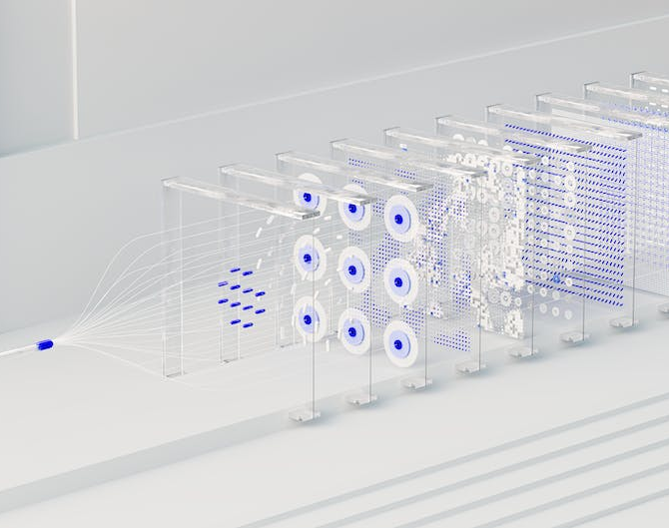
System Updates
Regularly patching and updating systems
Ensuring all software is up-to-date
Monitoring for new security updates
Notes:
Implementing strong security measures is essential for protecting your platform
Ensuring authentication and authorization protocols are secure
Encrypting data and monitoring network traffic
Using secure coding practices and regularly updating systems

Slide 40
Think, write, pair, share
This is a flowchart. A flowchart can be used to visually represent an algorithm or program.
Question .
What do you think will happen when this flowchart is executed as a program?
Start
welcome
Output “Hello world!”
welcome
End
End

Slide 41
Think, write, pair, share
The code will output “Hello world!” on the screen for the user.
Main
welcome
welcome
Output “Hello world!”
End
End
Hello world!

Slide 42
Flowcharts representing code
Flowcharts are used when designing programs.
They should be clear and precise, just like your code.
Flowcharts are read from top to bottom.
Start
welcome
welcome
Output “Hello world!”
End
End

Slide 43
Flowcharts representing code
1
2
3
4
def welcome():
print("Hello world")
welcome()
Start
welcome
Output “Hello world!”
welcome
Start will be executed first as it is the main program.
Terminators (oval shapes) are used to show the start and end of the program or subroutines.
End
End

Slide 44
Flowcharts representing code
1
2
3
4
def welcome():
print("Hello world")
welcome()
Start
welcome
Output “Hello world!”
welcome
Arrows are used to show the flow of the program.
The arrow heads represent the direction of the flow.
End
End

Slide 45
Flowcharts representing code
1
2
3
4
def welcome():
print("Hello world")
welcome()
Start
welcome
Output “Hello world!”
welcome
Welcome is referring to a subroutine call.
A subroutine call is represented by a rectangle with two lines at each side.
End
End

Slide 46
Flowcharts representing code
1
2
3
4
def welcome():
print("Hello world")
welcome()
Start
welcome
Output “Hello world!”
welcome
The subroutine is then executed.
End
End

Slide 47
Flowcharts representing code
1
2
3
4
def welcome():
print("Hello world")
welcome()
Start
welcome
Output “Hello world!”
welcome
Subroutines are created in separate flowcharts that are linked via name and symbol.
End
End

Slide 48
Flowcharts representing code
1
2
3
4
def welcome():
print("Hello world")
welcome()
Start
welcome
Output “Hello world!”
welcome
An output is represented using a parallelogram. This symbol is also used for inputs.
End
End
Hello world!

Slide 49
Flowcharts representing code
1
2
3
4
def welcome():
print("Hello world")
welcome()
Start
welcome
Output “Hello world!”
welcome
At the end of the subroutine it will return to the main program. The same thing happens with your flowcharts.
End
End
Hello world!

Slide 50
Flowcharts representing code
1
2
3
4
def welcome():
print("Hello world")
welcome()
Start
welcome
Output “Hello world!”
welcome
The main program will then resume.
Or in this case, end.
End
End

Slide 51

Flowcharts representing code
Start
Output “Hello world!”
An input or output is represented by a parallelogram.
There are many more symbols that can be used with flowcharts, which will be introduced in the coming lessons.
Terminators are used for the start and end of subroutines or programs.
Arrows are used to show the direction and flow of the program.
Subroutines are represented by a rectangle with two lines either side.
Input name
welcome

Slide 52

Design a flowchart
After a demonstration of the software, begin designing a flowchart for a maths mind-reading trick.
Find the instructions in the ‘Design a flowchart’ handout.
Notes:
A3 Worksheet – Design a flowchart

Slide 53
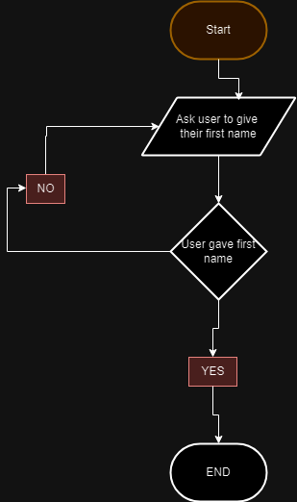
Design a flowchart for your calculator.
Learn: https://www.youtube.com/watch?v=Z0D96ZikMkc
Success criteria:
Use more than 5 types of shapes to describe your program flow across two different shape groups.
Use text where needed so when your colleague needs to write the code it would have clear objectives.
Create a graphic output and include it in your week 3 assignment booklet.
https://www.drawio.com/

Slide 54
What are these symbols used for?

Slide 55
What are these symbols used for?
Terminator: To symbolise the start and end.
Subroutine call: To symbolise a change of flow in execution to a subroutine.
Input/Output: To symbolise data being input or displayed for the user.

Slide 56
Learning Outcomes
Following this session, you should be able to:
Concept of software platforms.
Importance of platform-specific design and development.
Cross-platform development and its challenges.
Platform-specific performance optimisation techniques.
Considerations for cloud vs. on-premises software deployments.
Platform security considerations.
Understand flowchart symbols.

Slide 57

Questions?

Slide 58
Thank You

